Slide 1
Amazon Sales Data Analysis Report
Priyanshu Prakash

Slide 2
Problem Statement
Objective
The primary objective of this analysis is to uncover key insights from Amazon’s sales data to help business stakeholders make data-driven decisions.
This includes understanding sales trends, profit margins, product performance, and sales representative contributions.
Amazon handles massive sales data daily. However, analyzing this data manually is inefficient. The challenges include:
Identifying top-performing and underperforming products.
Analyzing sales trends over time (monthly, quarterly, yearly).
Understanding profit margins and discount impacts.
Assessing sales representatives' performance.
Providing actionable recommendations to optimize sales strategies.

Slide 3
Dataset Description
Customer Information:
CustKey – Unique identifier for each customer.
Sales Details:
Sales Amount – Total revenue generated from sales.
Sales Quantity – Number of units sold.
Sales Price – Price per unit of the product.
Sales Cost Amount – Cost incurred to sell the product.
Sales Margin Amount – Profit earned per product sale.
Order & Delivery Information:
Order Number – Unique identifier for each order.
Invoice Date – Date when the invoice was generated.
Promised Delivery Date – Expected date for order delivery.
Product Information:
Item – Name of the product sold.
Item Class – Category or classification of the product.
List Price – Original listed price before any discounts.
Discount Amount – Discount applied to the product.
Sales Representative Details:
Sales Rep – Salesperson responsible for the transaction.

Slide 4
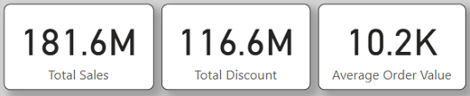
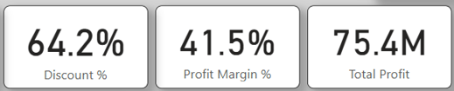
Essential Insights
Total Sales: $181.6M, with 75.4M in profit.
High Discount Rate: 64.2%, indicating a strong promotional strategy.
Profit Margin: 41.5%, suggesting a decent profitability rate.
Top-selling product categories contribute significantly to revenue.
Yearly and quarterly trends highlight fluctuations in sales volume and profits.

Slide 5
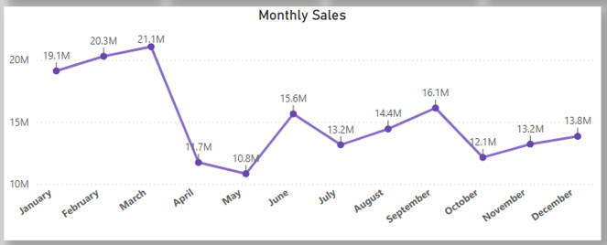
Monthly Sales Trends
Sales peaked in March (21.1M) but dipped in May (10.8M).
Sales recovery was seen in June and September.
Possible seasonal effects impacting monthly revenue.

Slide 6
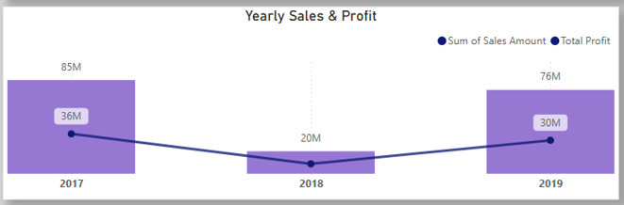
Yearly Sales & Profit Analysis
2017 saw the highest sales ($85M), while 2018 had the lowest ($20M).
Sales dropped in 2018 but increased again in 2019, indicating business recovery.
Profit trends followed sales, with a steady margin across years.

Slide 7
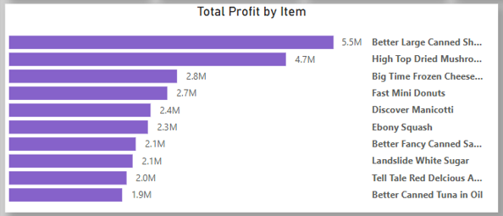
Total Profit by Item
Better Large Canned Product: Highest profit-generating item ($5.5M).
Frozen Cheese & Dried Mushrooms: Also contributed significantly to total profit.
Identifies best-selling and most profitable items.

Slide 8
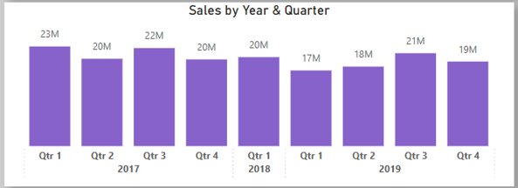
Sales by Year & Quarter
Q1 2017 had the highest sales ($23M).
Sales were relatively stable in 2019, unlike 2018, which saw a dip.
Seasonality impact visible across quarters.

Slide 9
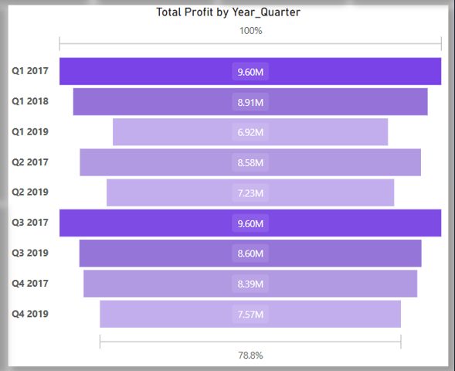
Total Profit by Year & Quarter
Highest Profit in Q1 2017 ($9.6M), indicating strong early-year performance.
Q4 2019 showed lower profit ($7.57M) despite good sales, possibly due to high discounts.

Slide 10
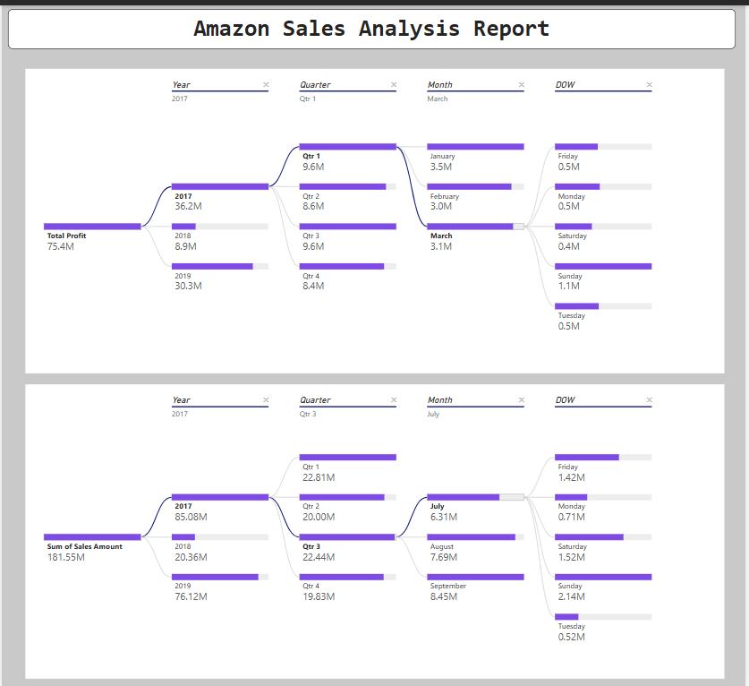
Sales Breakdown by Day of the Week
Friday & Sunday showed peak sales.
Monday & Tuesday had the lowest sales, suggesting less customer engagement on these days.

Slide 11
Conclusion
The Amazon Sales Analysis provided valuable insights into revenue trends, product performance, and seasonal fluctuations.
Key takeaways:
✅ March & Q1 are peak sales periods. ✅ 2018 had the lowest sales; 2019 showed a recovery. ✅ Certain items drive major profits, while discounts significantly impact margins. ✅ Sales vary by day, with weekends performing better.
Business Recommendations:
📌 Optimize pricing and discount strategies to maintain profit margins. 📌 Focus on high-profit products to maximize revenue. 📌 Leverage peak sales periods (March, Q1) for promotions. 📌 Improve customer engagement on low-sales days (Monday & Tuesday).

